Slide 1
Dimensionality Reduction: PCA & t-SNE
From High-Dimensional Data to Meaningful Representations
The Problem
The Methods
The Outcome
Real-world data lives in hundreds or thousands of dimensions — far beyond human intuition
PCA for linear compression · t-SNE for nonlinear visualization · both reveal hidden structure
Interpretable, compact representations that power downstream ML tasks and deep insight
Prerequisites Assumed
What You Will Learn
Basic linear algebra: matrices, vectors, dot products
Eigenvalues and eigenvectors (conceptual)
Python / scikit-learn familiarity
Why high dimensionality is a practical engineering problem
PCA: geometry, mathematics, and a worked numerical example
t-SNE: neighborhood preservation, KL divergence, perplexity
How to choose between them and implement both in Python

Slide 2






Why Do We Need Dimensionality Reduction?
The Core Challenge
Problems Caused by High Dimensionality
Can a human — or even a machine — meaningfully reason about data with 100, 1,000, or 10,000 features? Direct inspection fails. Distance metrics degrade. Models overfit. Visualization becomes impossible.
Visualization
Curse of Dimensionality
Dimensionality Reduction ≠ deleting columns. It means discovering the intrinsic geometric structure embedded in high-dimensional space and representing it compactly.
Human perception tops out at 3D. Patterns above that are invisible without reduction.
Distance metrics break down — all points become nearly equidistant in high dimensions.
High-Dimensional Real Data
Redundant Features
Overfitting Risk
Correlated features add noise, not signal, increasing computational cost.
Models learn noise rather than structure when features outnumber informative signals.
Images
Customer Data
The Goal
Thousands of pixels per image
Hundreds of behavioral features
Map X ∈ ℝn×d (high-dimensional) → Z ∈ ℝn×k (low-dimensional, k ≪ d) while preserving the information that matters for your task.
Text (TF-IDF)
Genomics
Thousands of vocabulary terms
Thousands of gene expression values

Slide 3



From Many Features to Fewer Dimensions
Mathematical Representation
Today's Two Methods — Side by Side
Original dataset: X ∈ ℝn×d — n samples, d features
After reduction: Z ∈ ℝn×k — n samples, k dimensions, k ≪ d
1
2
Concrete example: 1,000 samples × 50 features → 1,000 samples × 2 dimensions. The 48 discarded dimensions carried redundant or low-variance information.
PCA — Principal Component Analysis
t-SNE — t-Distributed Stochastic Neighbor Embedding
Type: Linear transformation
Preserves: Directions of maximum variance
Strengths: Fast, interpretable, invertible, works on new data
Best for: Preprocessing, compression, noise reduction
Type: Nonlinear embedding
Preserves: Local neighborhood structure
Strengths: Reveals clusters and curved manifolds
Best for: 2D/3D visualization and exploration
Two Broad Strategies
Feature Selection
Choose a subset of original features. Columns remain interpretable. Example: keep Age and Income, drop the rest.
Feature Extraction
Create new dimensions as linear (or nonlinear) combinations. Example: Feature₁ + Feature₂ + Feature₃ → Principal Component 1.
PCA
Transform features into orthogonal principal components.
Feature Selection
t-SNE
Choose informative features to reduce dimensionality.
Embed high-dimensional data into a 2D representation.

Slide 4


PCA: Find the Direction That Captures Maximum Variance
Geometric Intuition
Mathematical Form
Start with 2D data: Study Hours (X₁) vs Exam Score (X₂). Points form a diagonal elongated cloud — they are correlated. PCA asks: which single direction, if we projected all points onto it, would spread them the most?
Each principal component is a linear combination of original features:
Step 1 — Observe the cloud
The weight vector w defines the projection direction. It is chosen to maximize the variance of the projected values:
Data points are not scattered randomly — they cluster along a diagonal axis reflecting the correlation between study time and exam performance.
Step 2 — Find the best direction
PC2 is orthogonal to PC1, capturing the next-largest variance, and so on. Each subsequent component is uncorrelated with all previous ones.
PC1 = the direction of maximum spread. A bad direction captures little variance; the optimal direction maximizes it.
PC1 is guaranteed to capture more variance than any other single linear projection of the data.
Step 3 — Project and reduce
Drop the perpendicular component (PC2, which captures residual variance). The 2D problem becomes 1D with minimal information loss.

Slide 5


PCA Mathematics — Step by Step
Raw Data
Mean Centering
Covariance Matrix
Eigenvectors
Step 1 — Center the Data
Step 4 — Sort by Eigenvalue
Rank all eigenvectors by their eigenvalue. PC1 corresponds to λ₁ (largest), PC2 to λ₂, etc.
Subtract the column mean from every feature. Required so the covariance matrix captures spread, not location.
Step 5 — Project Data
Step 2 — Covariance Matrix
W is the d × k matrix whose columns are the top k eigenvectors. Z is the final low-dimensional representation.
A d × d symmetric matrix. Entry Σᵢⱼ measures how features i and j vary together.
Implementation note: Real-world PCA uses Singular Value Decomposition (SVD) rather than explicit eigendecomposition — it is numerically more stable and often faster for large matrices.
Step 3 — Eigenvalue Problem
v = eigenvector (the principal direction) · λ = eigenvalue (variance explained in that direction)

Slide 6

PCA Worked Example — Calculate It
Dataset — 5 Students
Step 4 — Eigendecomposition Result
Largest eigenvalue λ₁ ≈ 148.1 → accounts for approximately 95% of total variance.
PC1 direction: mostly aligned with Exam Score, with a smaller Study Hours contribution — exactly as the strong correlation suggests.
Student | Study Hours (X₁) | Exam Score (X₂)
A | 1 | 50
B | 2 | 55
C | 3 | 65
D | 4 | 70
E | 5 | 80
Step 5 — Reduction
Projecting onto PC1 alone retains 95% of the information, reducing storage and computation with minimal loss.
Step 1 — Compute Means
Key observation: The high covariance (35) between X₁ and X₂ is exactly what PCA exploits — correlated features are redundant, and PCA collapses them into one compact dimension.
Step 2 — Centered Data
Practical Note
[−2, −14] · [−1, −9] · [0, +1] · [+1, +6] · [+2, +16]
Real implementations use sklearn.decomposition.PCA with SVD internally. Manual eigendecomposition is for understanding, not production.
Step 3 — Covariance Matrix
Var(X₁) = 2.5 · Var(X₂) = 147.5 · Cov(X₁, X₂) = 35

Slide 7
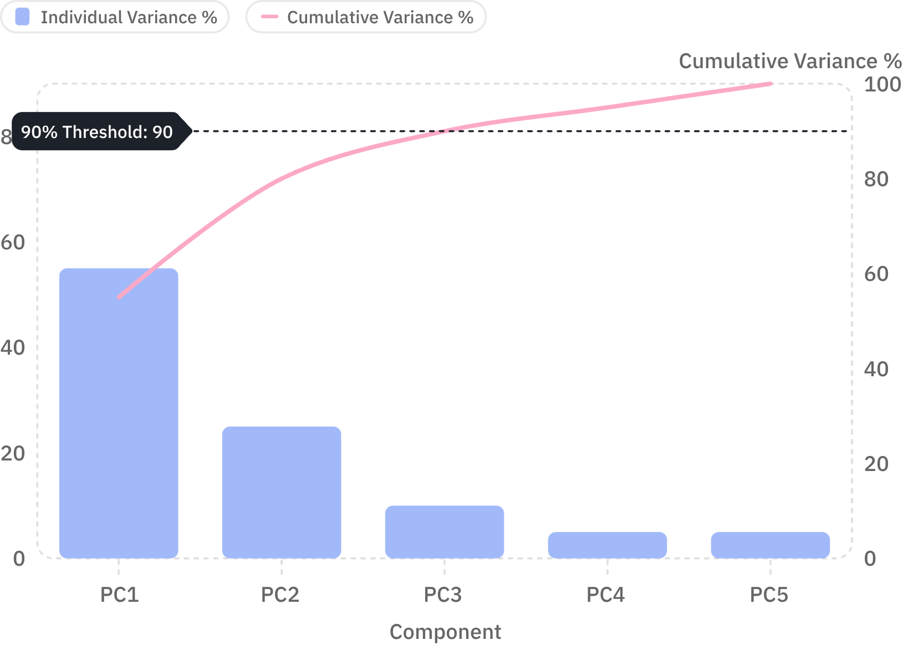

How Many Principal Components Should We Keep?
Explained Variance Ratio
Scree Plot — Explained Variance per Component
Fraction of total variance explained by the i-th component alone.
Cumulative Explained Variance
Cumulative fraction explained by the top k components. Choose k where CVₖ crosses your threshold.
Example Breakdown
Component | Variance % | Cumulative %
PC1 | 55% | 55%
PC2 | 25% | 80%
PC3 | 10% | 90%
PC4 | 5% | 95%
PC5 | 5% | 100%
Bars show individual variance (left axis) · Line shows cumulative variance (right axis) · Dashed line marks the 90% threshold
There is no universal threshold. 95%, 99%, or 90% — the right cutoff depends on your downstream task and tolerance for information loss.
Decision: If 90% variance is acceptable for your task, choose k = 3 components and discard PC4 and PC5.

Slide 8

t-SNE: Preserve Local Neighborhoods
The Limitation of PCA
High-Dimensional Similarity (Gaussian Kernel)
PCA searches for linear directions of maximum variance. It fails to capture curved, spiral, or otherwise nonlinear structure in data.
Imagine a Swiss-roll dataset: a 2D sheet rolled up in 3D space. PCA projects it flat but tears the structure. t-SNE unrolls it.
pⱼ|ᵢ = probability that point i would "pick" point j as a neighbor. Nearby points → high probability · Distant points → near zero.
t-SNE Core Idea
1
Neighborhood Preservation — Concrete Example
Model High-D Neighborhoods
For each point, compute a probability distribution over its neighbors using a Gaussian kernel. Nearby points get high probability; distant points near zero.
High-D Space
2D Embedding
Point A is close to B, C, D · Far from X, Y, Z
A stays near B, C, D · A remains far from X, Y, Z
2
Create a 2D Layout
Initialize a random 2D embedding. Compute analogous probabilities in 2D using a heavier-tailed Student-t distribution.
t-SNE does NOT preserve global distances. Clusters that appear far apart in 2D do not necessarily mean they are far apart in the original space.
3
Minimize the Difference
Optimize the 2D positions until the 2D probability distributions match the high-dimensional ones as closely as possible.

Slide 9


t-SNE Mathematics & Perplexity
Step 2 — Low-Dimensional Probabilities (Student-t)
Effect of Perplexity on t-SNE Embeddings
1
2
The Student-t distribution has heavier tails than a Gaussian. This means that to match a high-D "close" probability, two points in 2D must be brought very close, and to match a "far" probability they are pushed very far. The result: clusters become tight and well-separated in 2D.
Perplexity = 5
Perplexity = 30
Very local neighborhoods. Points cluster in many small, fragmented groups. Noisy, hard to interpret globally.
Balanced neighborhood size. Moderate, well-separated clusters emerge. Default — usually best starting point.
Step 3 — KL Divergence Objective
3
Minimize via gradient descent. The cost is asymmetric: representing a nearby high-D pair as far apart in 2D is penalized much more heavily than the reverse.
Perplexity = 50
Larger effective neighborhoods. Tighter macro-clusters, but finer local structure may be smoothed out.
Perplexity — Effective Neighborhood Size
Critical limitations: (1) Different perplexity values can produce visually different embeddings of the same data. (2) Clusters in 2D do not automatically correspond to true class labels. (3) Distances between distant clusters are not meaningful in t-SNE. Always validate cluster interpretations against ground truth.
H(Pᵢ) is the Shannon entropy of the conditional distribution. Typical range: 5–50. Perplexity must be smaller than the number of samples.
Run t-SNE multiple times with different random_state values and compare — if structure is real, it reproduces.

Slide 10





PCA vs t-SNE: When to Use Which?
Head-to-Head Comparison
Property | PCA | t-SNE
Type | Linear | Nonlinear
Main Goal | Preserve variance | Preserve local neighborhoods
Interpretability | High — components have meaning | Lower — axes are abstract
Global Structure | Well preserved | Can be distorted
Transform New Data | Yes — standard transform | Not standard — must re-run
Speed | Fast — O(nd²) | Slow — O(n² ) or O(n log n)
Primary Use | Preprocessing · Compression · Noise reduction | Visualization · Exploration · Cluster discovery
Python Workflow — scikit-learn
Best Practice Pipeline
from sklearn.preprocessing import StandardScaler
from sklearn.decomposition import PCA
from sklearn.manifold import TSNE
# Step 1: Always scale first
X_scaled = StandardScaler().fit_transform(X)
# Step 2: PCA (compression / preprocessing)
pca = PCA(n_components=2)
X_pca = pca.fit_transform(X_scaled)
print(pca.explained_variance_ratio_)
# Step 3: t-SNE (visualization)
# For high-D data, apply PCA first to reduce noise
X_50 = PCA(n_components=50).fit_transform(X_scaled)
tsne = TSNE(n_components=2, perplexity=30, random_state=42)
X_tsne = tsne.fit_transform(X_50)
Standardize
PCA 50D
t-SNE 2D
Real-World Applications
Computer Vision
NLP
PCA compresses pixel spaces before feeding into classifiers
Reduce TF-IDF or embedding dimensions for fast retrieval
Genomics
Customer Analytics
t-SNE reveals cell subtypes in single-cell RNA-seq data
Segment customers by behavior using t-SNE cluster visualization

